Slide 1
A study on Boardgames
A Webscraping Project

Slide 2
Brief History of Boardgames
Enjoyed for hundreds of years as a fun socializing tool. It can also used as an educational tool for exploring issues around the world and to develop various soft skills.
Games everybody know: Chess, Monopoly, Battleship, etc
Raise of popularity with popular culture reference, for example, table-top games are frequent scenes in the tv show such as “The Big Bang Theory”
How has boardgames evolved through time?

Slide 3
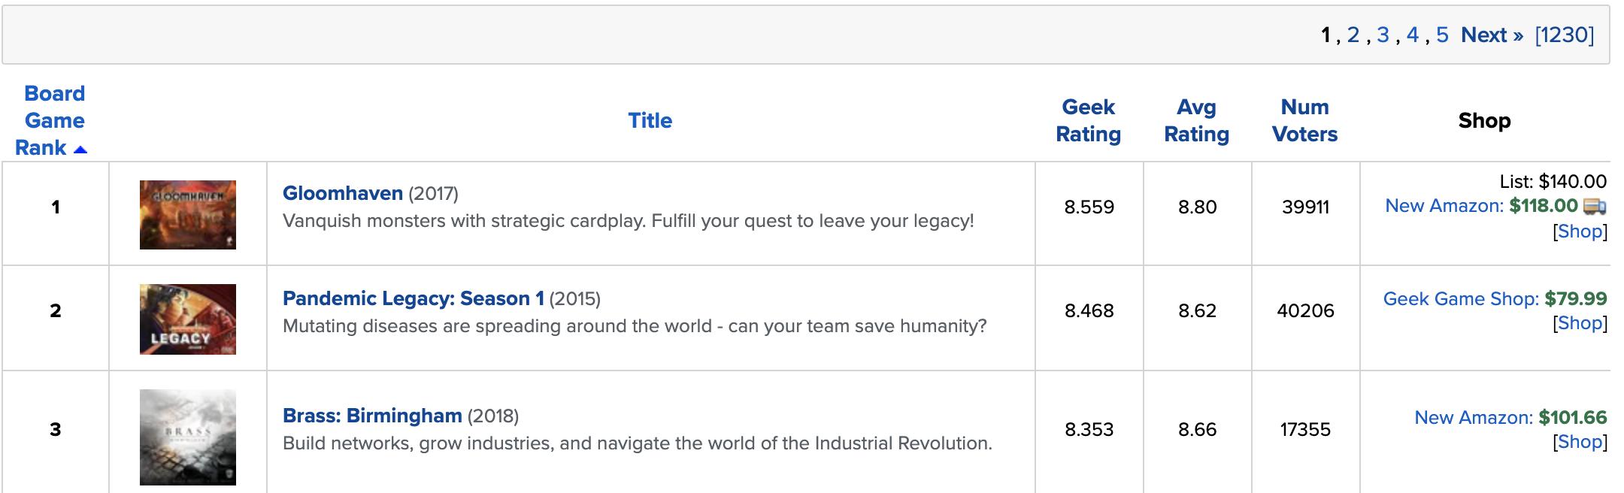
Data Collection Part 1
Boardgamegeek.com is an online resource and community for everything tabletop-games related with over 2 million registered users
Scraped their boardgame database containing over 120,000 games using scrapy
Avg Rating = simple weighted averages Geek Rating = Bayesian Averaging affecting mostly games with fewer number of voters

Slide 4
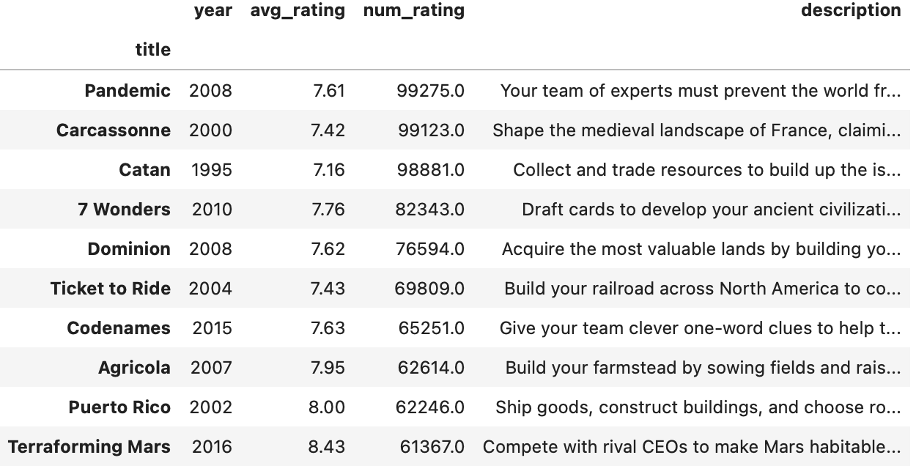
Top 10 Games by popularity:

Slide 5
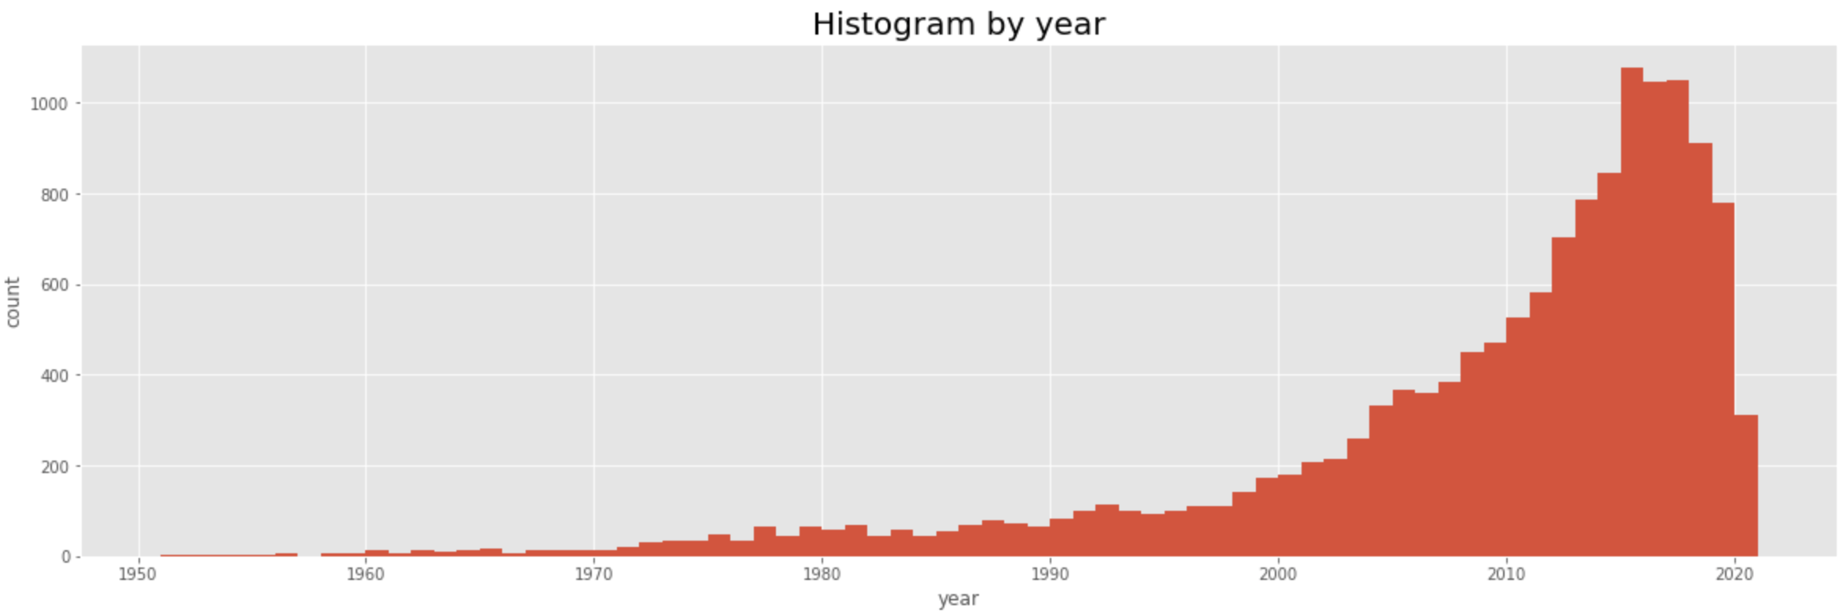
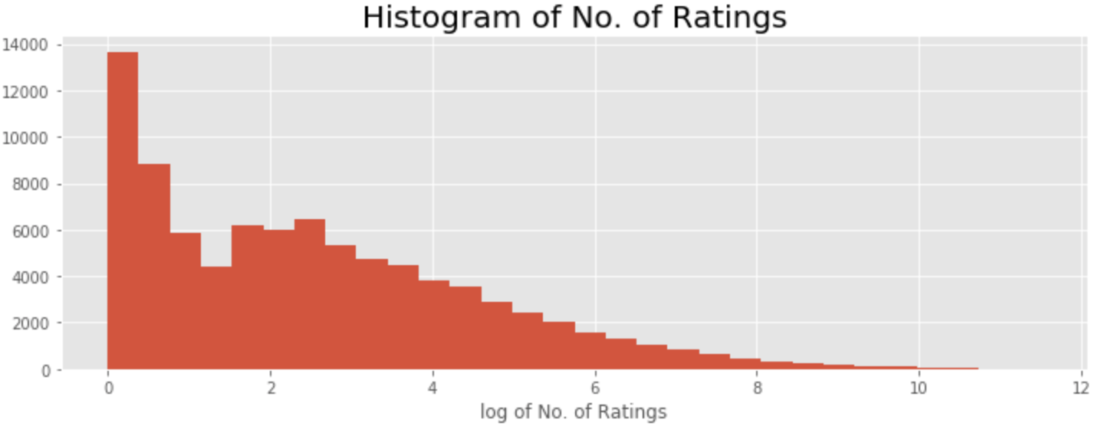

Slide 6
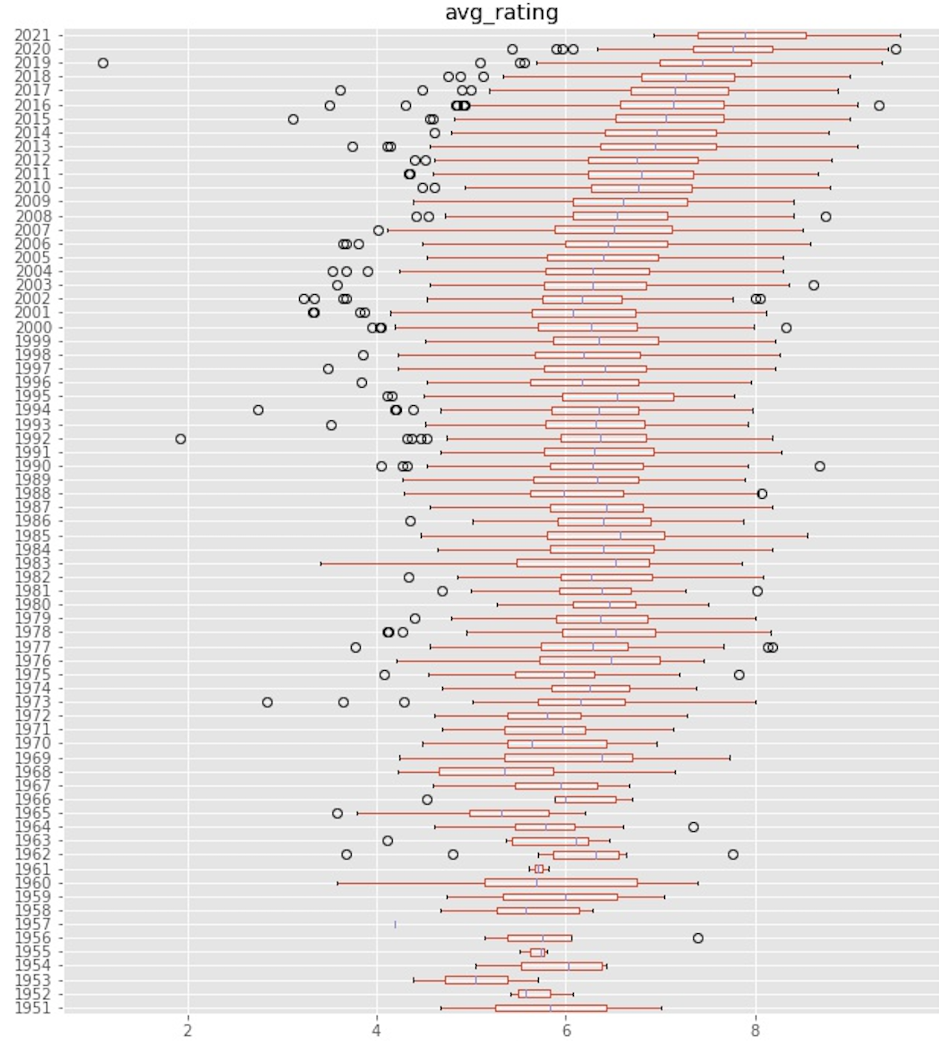
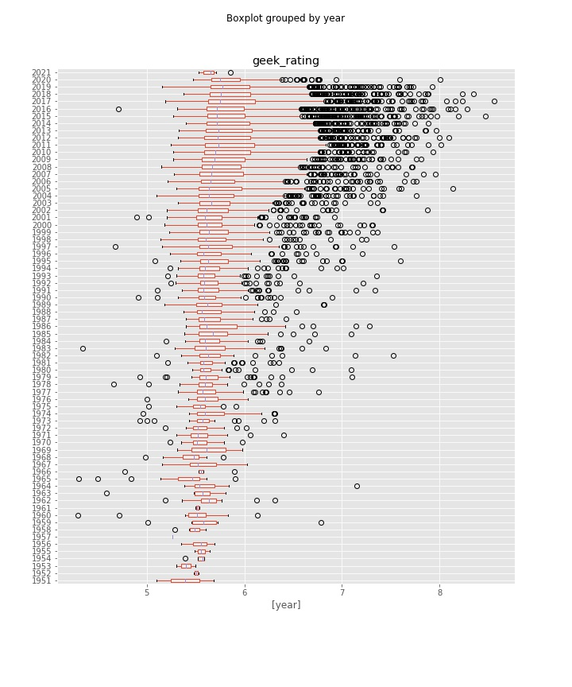

Slide 7

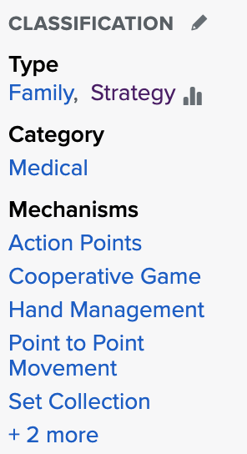
Data Collection Part 2
Filtered for games with over 100 ratings
Used selenium to scrape additional features on the filtered list of 10,000+ game

Slide 8
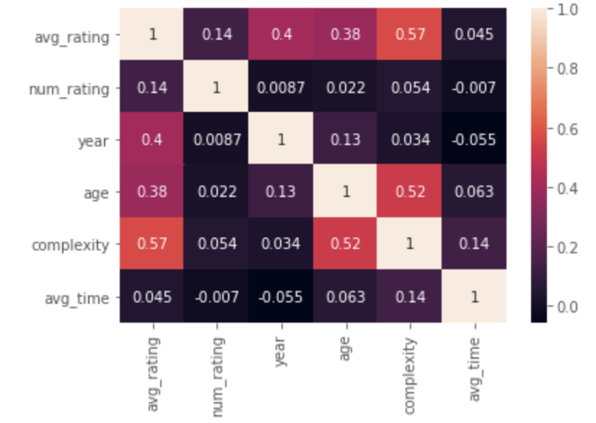
Correlation Heatmap:

Slide 9
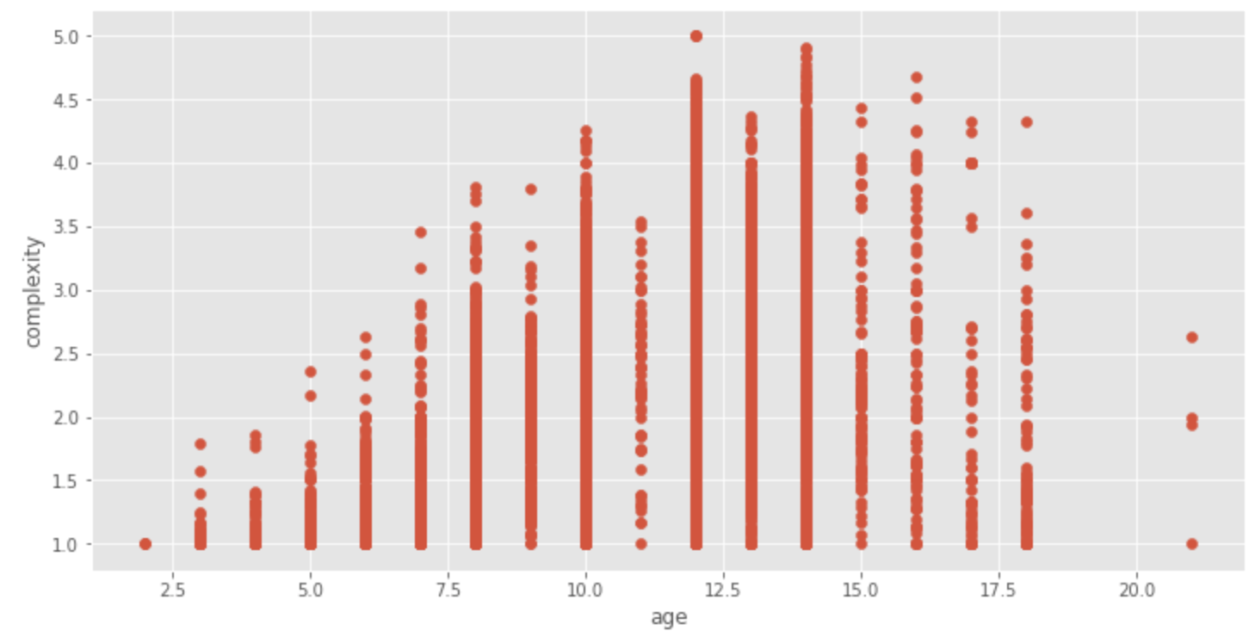

Slide 10
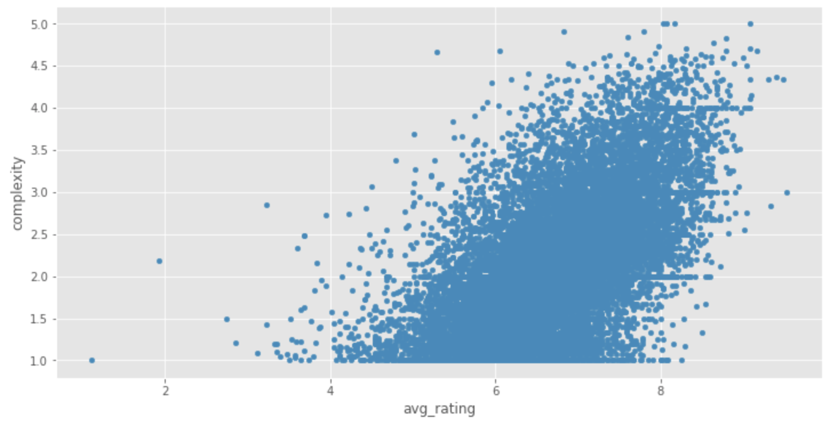

Slide 11
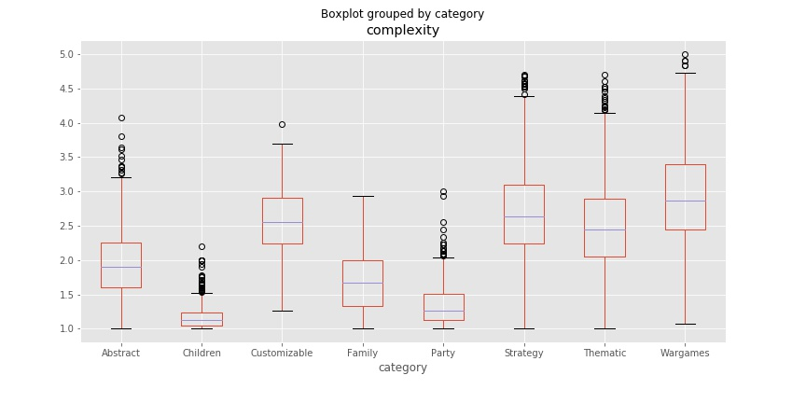

Slide 12



Slide 13
Conclusions:
Number of boardgames published has grew exponentially since 2000, as well as their popularity as judged by number of votes
The quality of the games have also improved in the same time period
There is an unexpected positive correlation between complexity and average rating of game, most likely due to the players and users of boardgamegeek.com database
In terms of categories, Children’s games are the least complex (as expected) followed by Family/ Party games. Most complicated games are of wargame types and strategy with the widest variety.

Slide 14
Further Work:
Scrape the prices of the games:
Can help to optimize problems relating to the budget
Using NLP on the subcategories and other unscraped fields like mechanisms of the games
Create an app

